Slide 1
Integrated structural and control system design (co-design) for robust flutter suppression
Author: Pilar Tagliero
Supervisors: Emmeline Faïsse
Joseph Morlier
2nd April, 2021

Slide 2
Outline
Introduction
Model of the system
• Aeroelastic model of the wing
• Control structure for active flutter supression
Optimization
Results
Conclusions & Future Work
Q&A: 15 min
Co-design for robust flutter supression
2° April 2021

Slide 3
Introduction
Flutter :
aeroelastic dynamical instability
big issue nowadays: + slenderness,
+ flexibility, + speed
active methods are attractive but hard to certificate
Source: www.youtube.com/watch?v=egDWh7jnNic
Structure Wing
Control system AFS system
The aim of this project is to simultaneously design the structure and control system of a wing
(Co-design) in order to suppress flutter instabilities
Co-design for robust flutter supression
2° April 2021

Slide 4
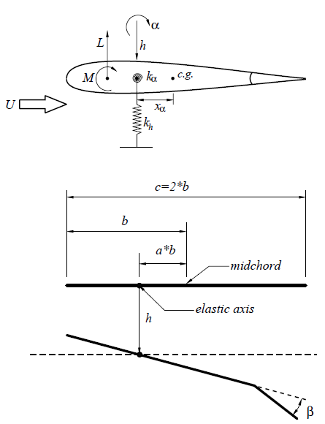
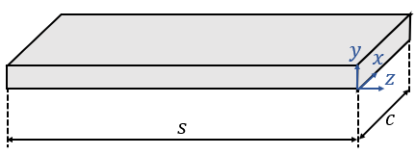
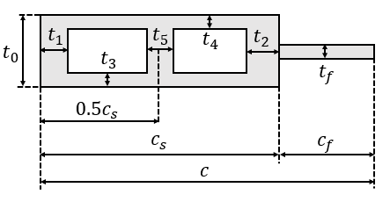
Model of the system: Aeroelastic Model
Reprinted from J. Ko, A. Kurdila, and T. Strganac [1997]
Co-design for robust flutter supression
2° April 2021

Slide 5
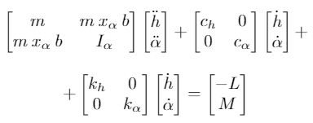


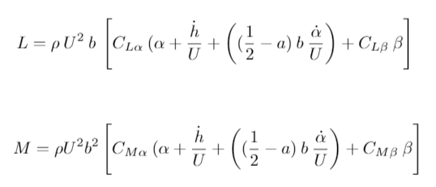
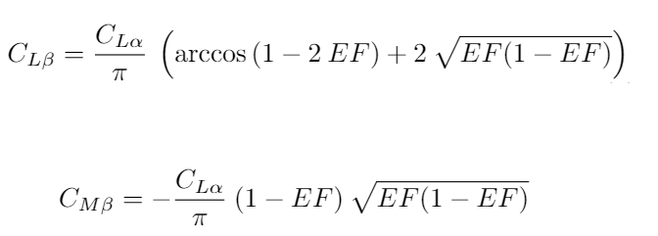
Model of the wing: Aeroelastic Model
EQUATIONS OF MOTION
NATURAL PULSATION OF A BEAM
(FIRST BENDING & TORSION MODES)
AERODYNAMIC LOADS
FLAP MODEL
Co-design for robust flutter supression
2° April 2021

Slide 6

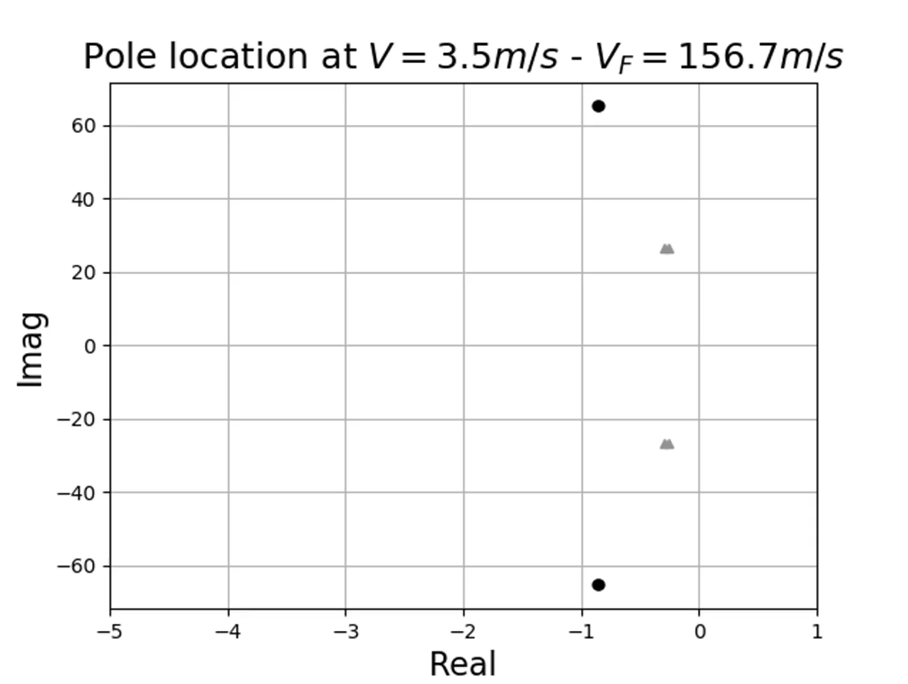
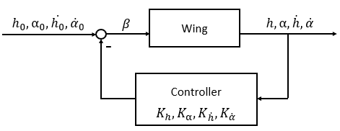
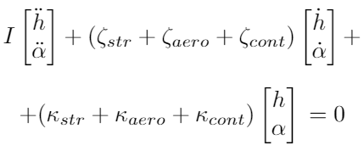
Model of the wing: Control Structure
Open Loop
Closed-Loop
+
=
Co-design for robust flutter supression
2° April 2021

Slide 7
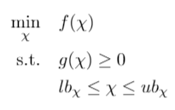

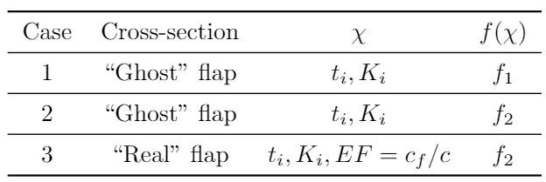




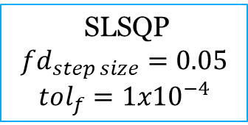
Optimization
SLSQP
$$fd_{step size}=0.05$$
$$tol_{f}=1{x10}^{−4}$$
• Theory of thin walls
• Flap chord: 10-25% of total chord
• Gains limited by actuator performance
Co-design for robust flutter supression
2° April 2021

Slide 8
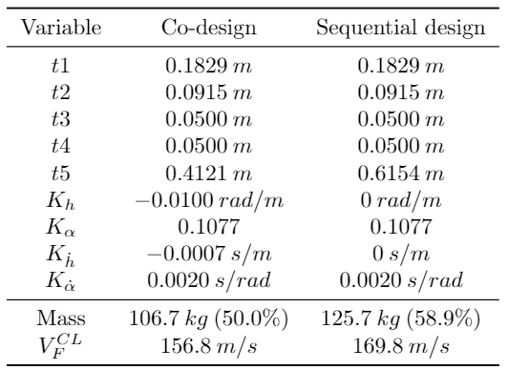
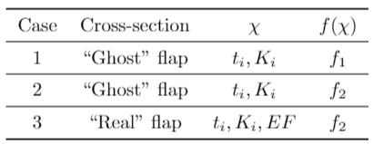
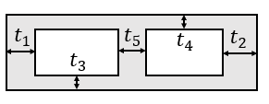

Results
I. Co-design improvement over sequential design
$↓50\% ↓$41.1%
Co-design for robust flutter supression
2° April 2021

Slide 9
Results
II. Maintaining or improving flutter performance
Co-design for robust flutter supression
2° April 2021

Slide 10
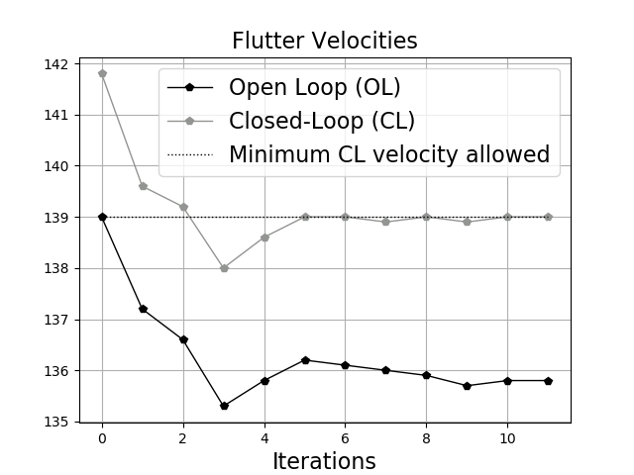
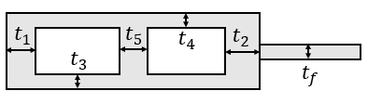
Results
III. Co-design of a thin-walled section with flap
20,25% of mass reduction
Optimal flap chord: 20,03%
Co-design for robust flutter supression
2° April 2021

Slide 11
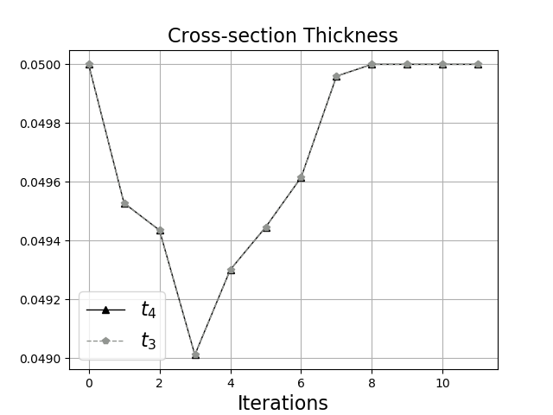
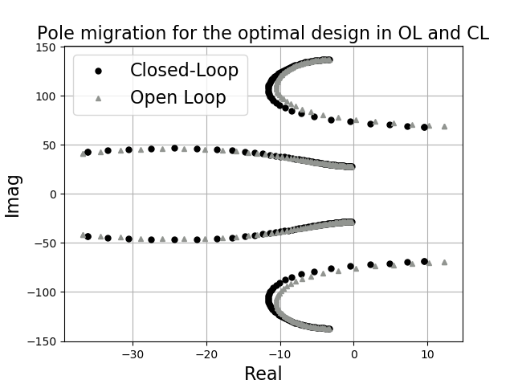
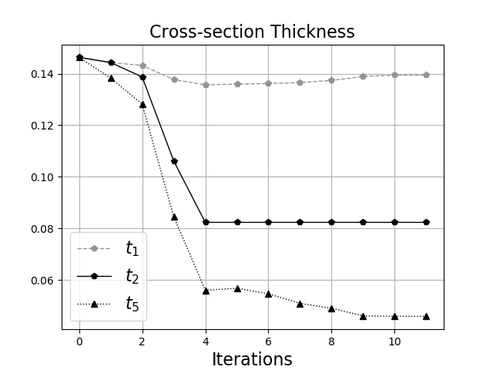
Results
III. Co-design of a thin-walled section
Co-design for robust flutter supression
2° April 2021

Slide 12
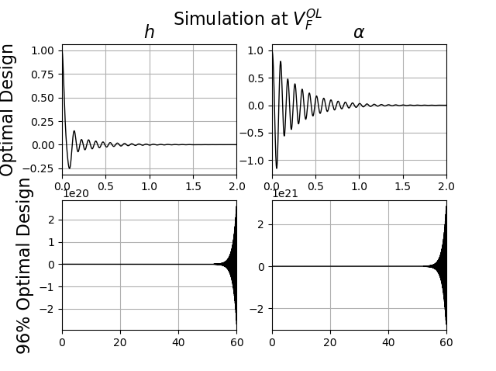
Results
IV. Preliminary Robustness Analysis
Co-design for robust flutter supression
2° April 2021

Slide 13

Conclusions & Future Work
CONCLUSIONS
Co-design allows to relax the flutter velocity in OL reaching lighter designs than with conventional design
Different objective functions, models and design variables were explored
The controller is not robust to thicknesses variations
FUTURE WORK
Consider robust control techniques such as LQR or Hinf
Make a stress based analysis
Solve the issue with the numerical approximation of the derivatives: OpenMDAO / Complex step-size approach
Improve the aeroelastic model: unsteady aerodynamics / flap model / torsion constant
Co-design for robust flutter supression
2° April 2021

Slide 14
Q&A
15 minutes

